Slide 1
SkillSwap
Key findings from the user interviews
Conducted by Faith Jegede & Isabella Oelofse

Slide 2
Diverse Experiences:
Users have varied experiences with skill exchange platforms, ranging from positive to mixed. This indicates a need for platforms to cater to different user preferences and address various challenges faced by users.

Slide 3
Challenges in Finding Matches:
Challenges in Finding Matches: Users commonly face challenges in finding suitable matches for skill exchange, including difficulties in finding matches that align with their specific interests, availability, and geographic location.

Slide 4
Expectations from Ideal Platforms:
Users expect ideal skill exchange platforms to have user-friendly interfaces, comprehensive search functionality, robust feedback systems, and clear communication channels. These features enhance the user experience and facilitate meaningfu

Slide 5
Preferred Connection Methods:
Users have varying preferences for connecting with others for skill exchange, with online messaging and video calls being the most popular methods due to their convenience and flexibility. other method include meeting in person

Slide 6
Concerns About Privacy and Security:
users express concerns about privacy and security when participating in skill exchange through online platforms. They expect platforms to prioritize data security and implement measures to protect users' personal information.

Slide 7
Part two: results from second survey conducting by Isabella Oelofse
Demographics:
Age group: 23-60
location: Berlin, Germany and Cape Town, South Africa
Exisitng skill exchange preferences:
Majority of participants often engage in one-on-one coaching as a form of sharing skills.
Majority of participants felt existing options for skill sharing were: not entertaining enough and not free
Features that were desired from a skill sharing platform:
outcome based
videos and photos
informal
easy to use

Slide 8
Additional resources or tools that are desired:
a way of making friends through the platform and skill sharing
saving money
video content
Reasons for sharing skills or learning from others:
It’s just cool to have some skills and help yourself, it’s cheaper than paying for a
professional, low barrier for FLINTA people to try some crafting
How it could help someone else find a career that is more fulfilling to them
There a very few people/organisations that can teach you everything in one field,
so therefore it is best to learn from lots of different people and through their experiences.
I would love to learn more handywork skills and languages and it’s more fun with someone else
Enjoy sharing knowledge and experience and to see others progress as a result
feels good to learn something new and it also feels nice to share with others

Slide 9
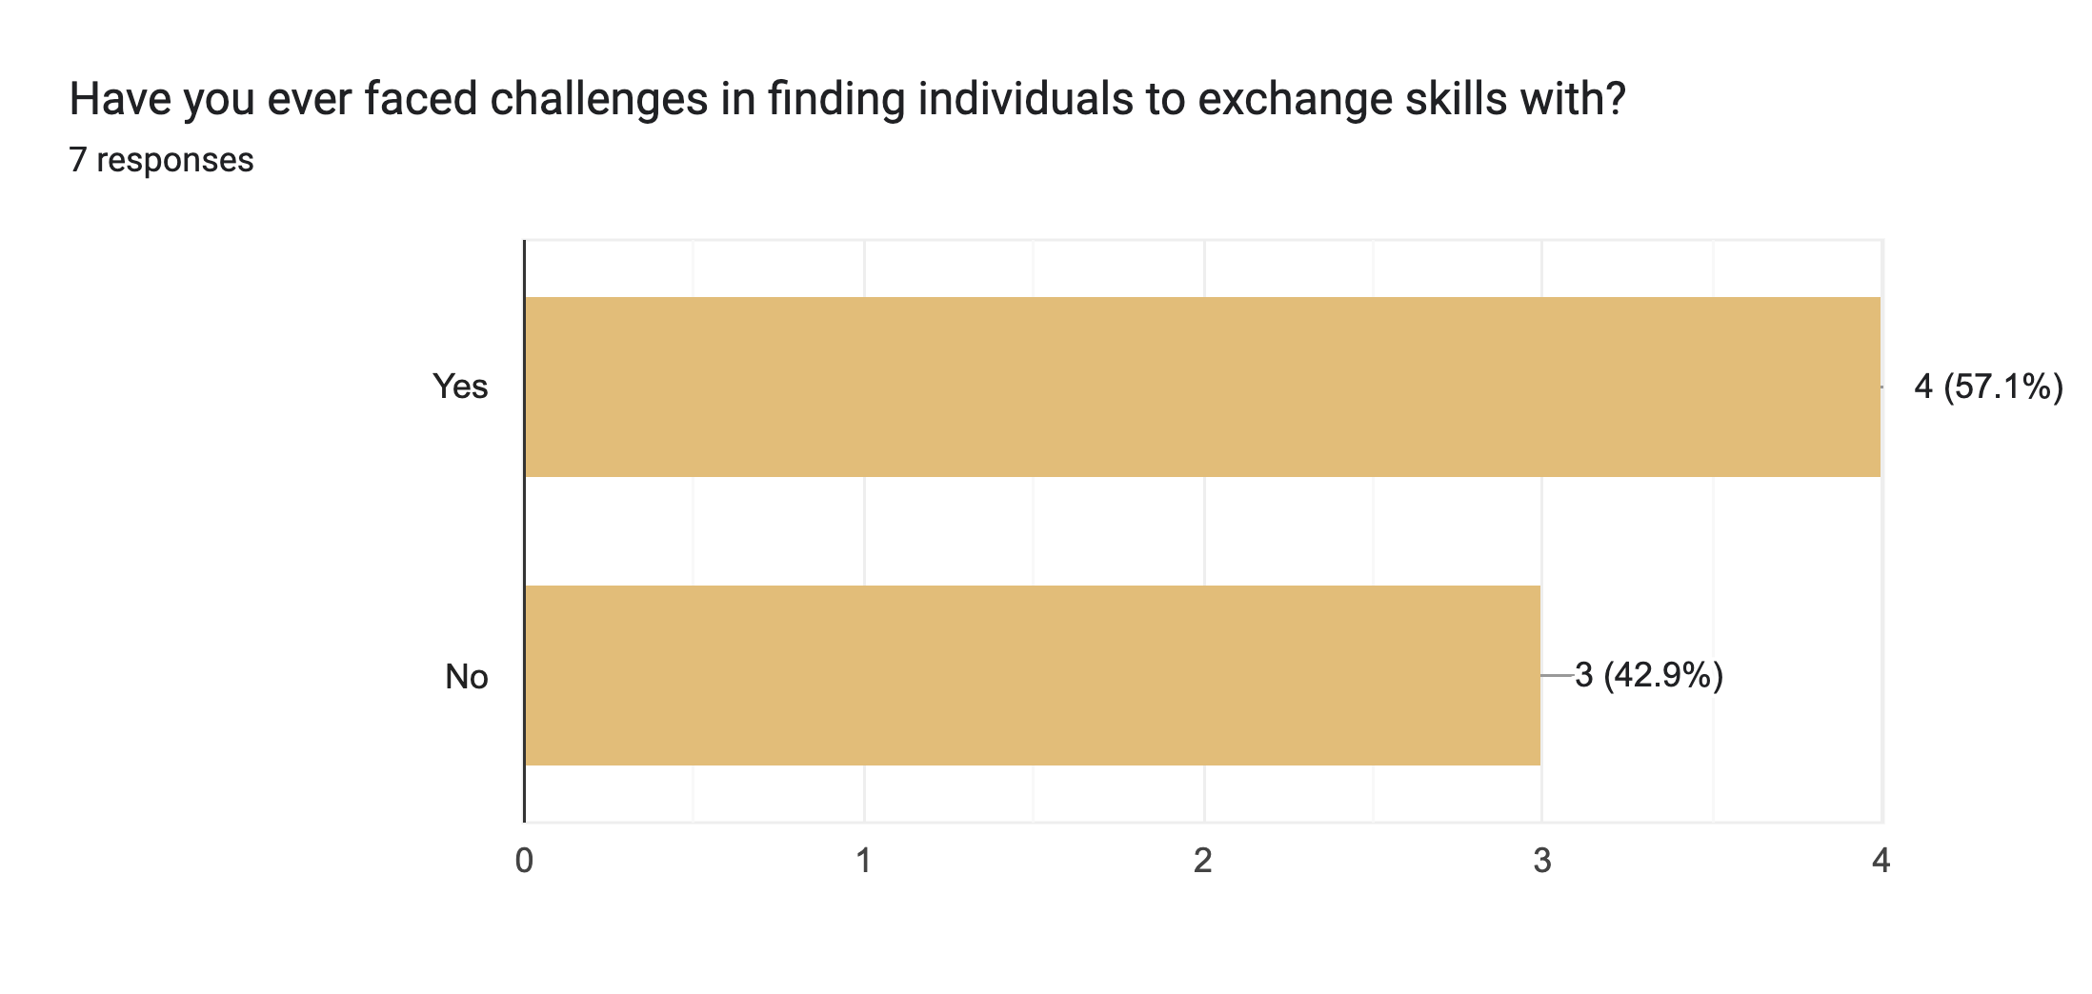

Slide 10
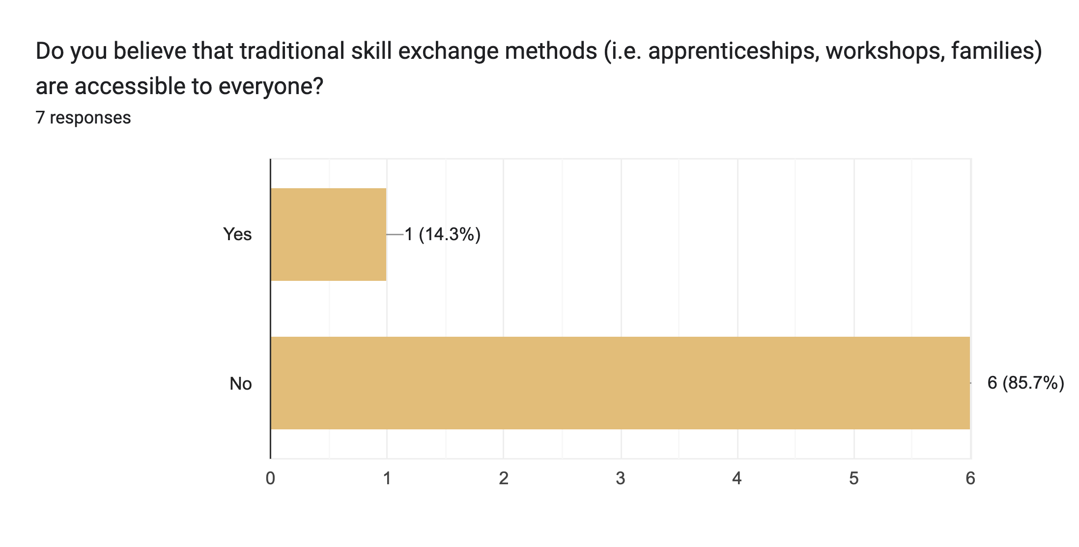

Slide 11
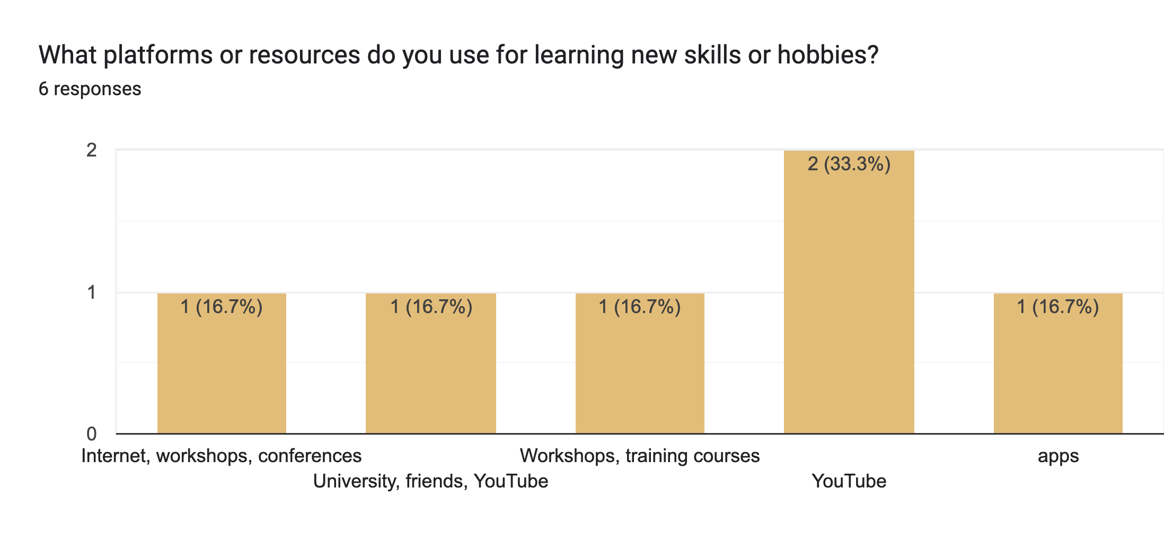

Slide 12
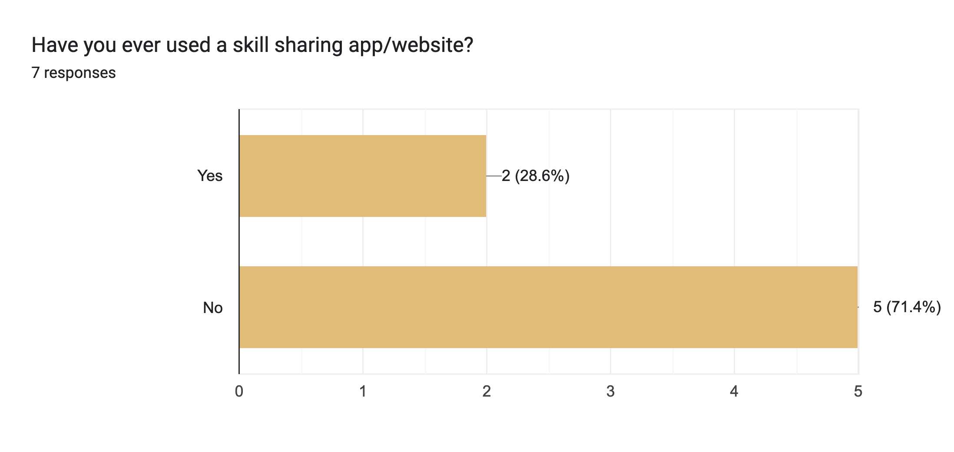

Slide 13
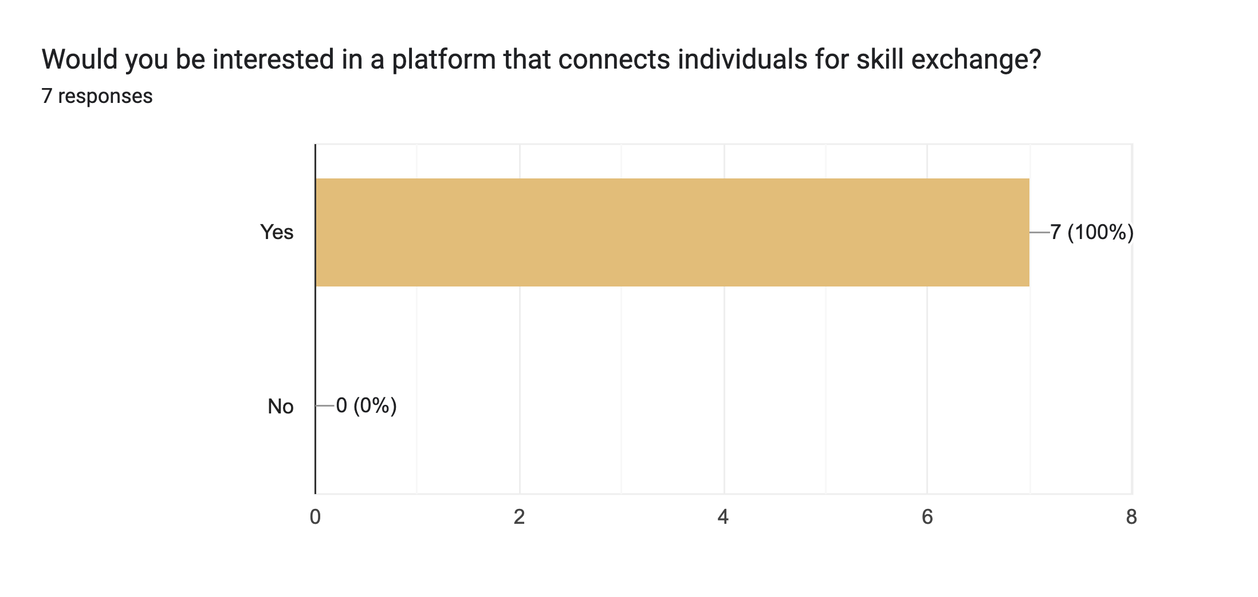

Slide 14
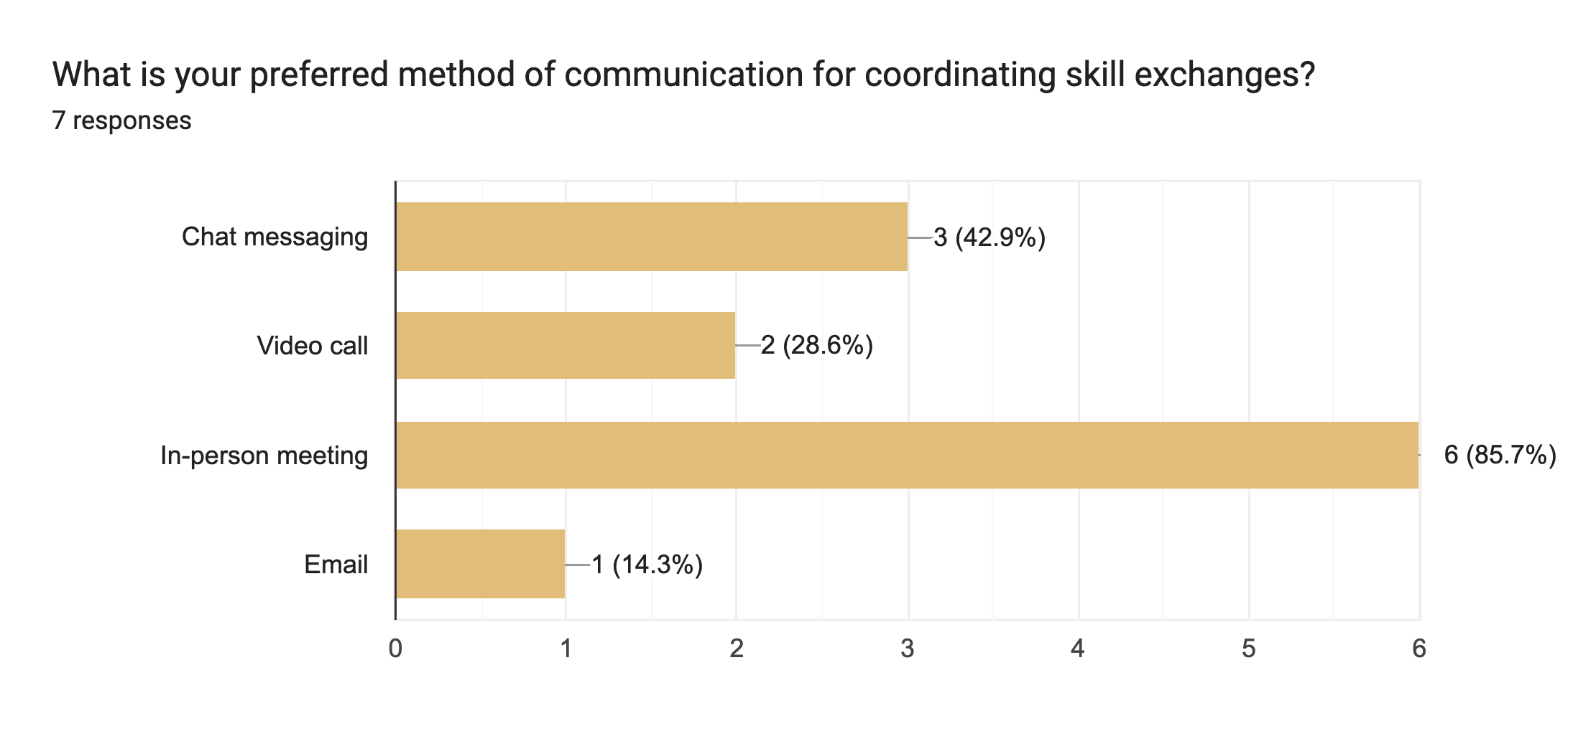

Slide 15
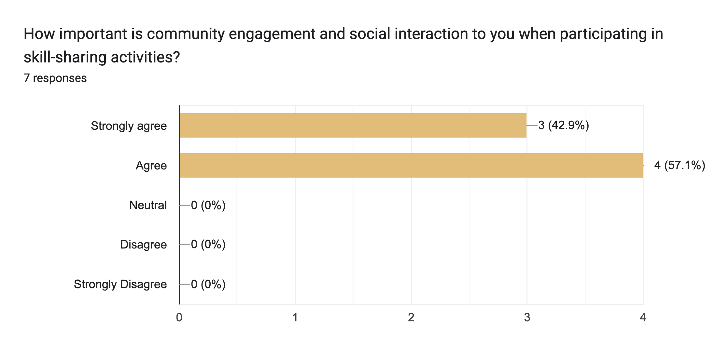

Slide 16
